Slide 1
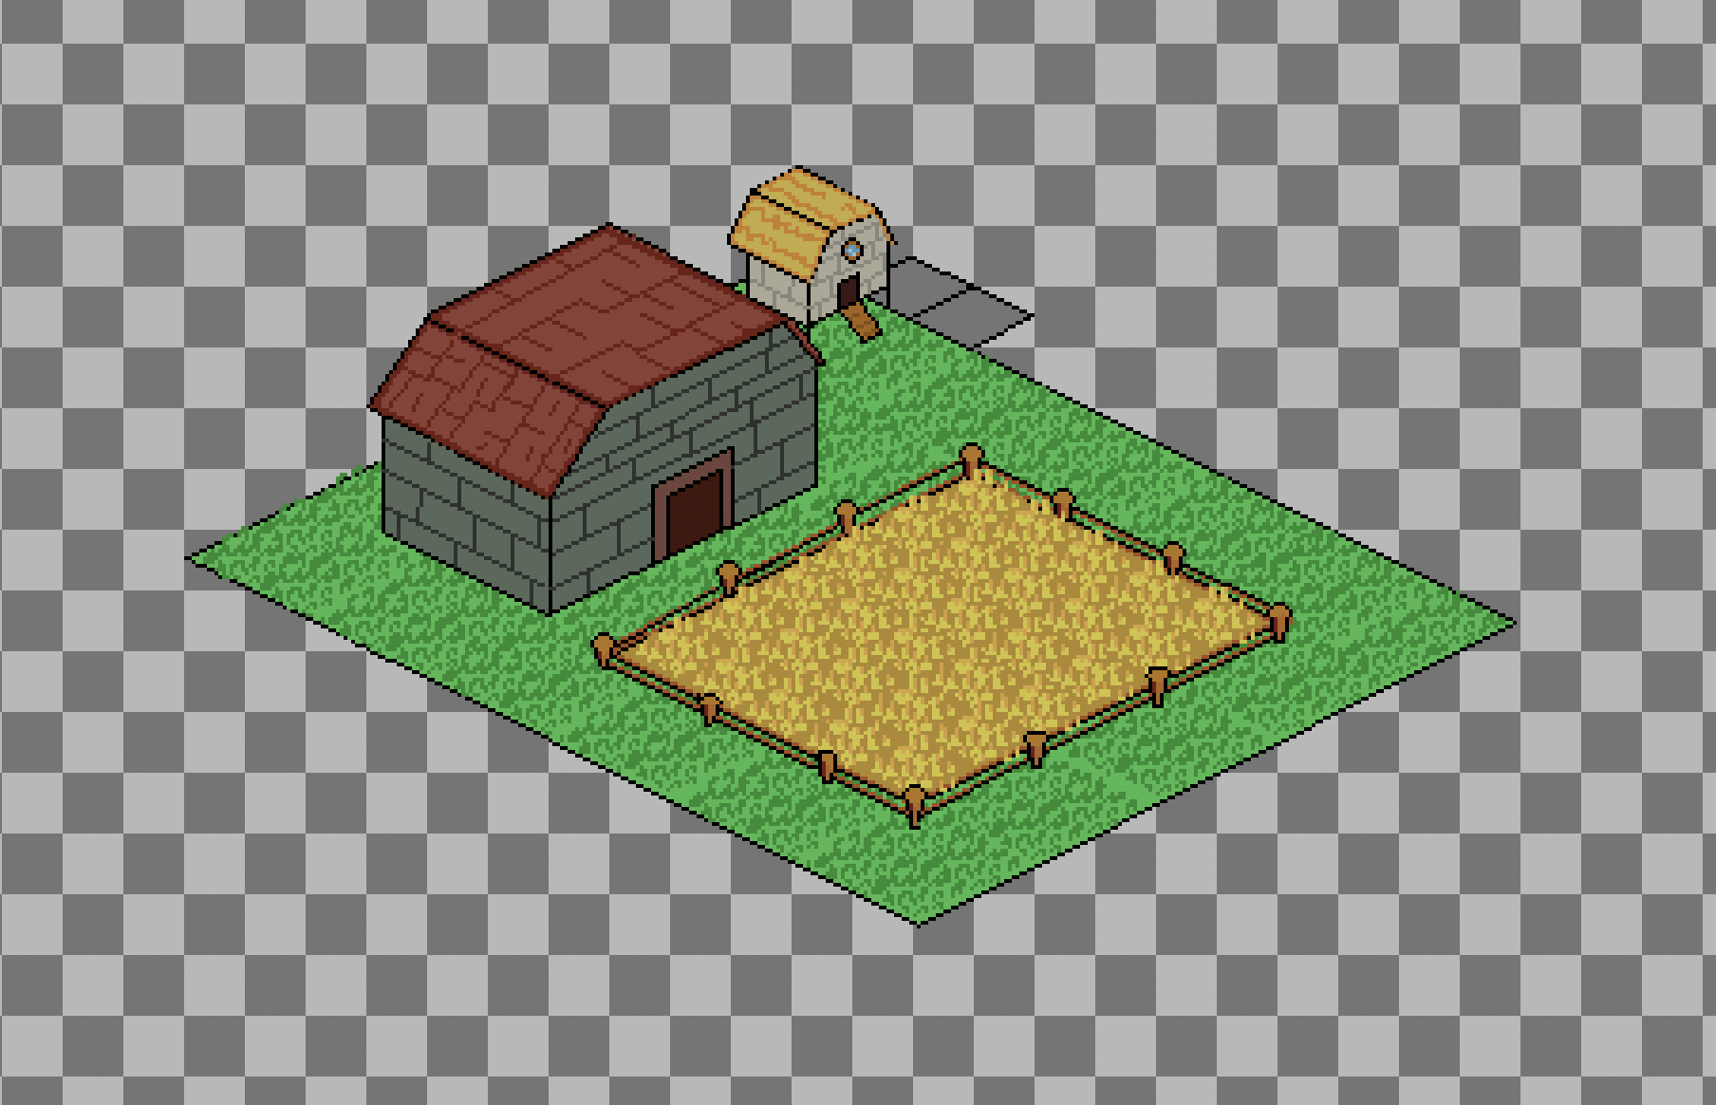
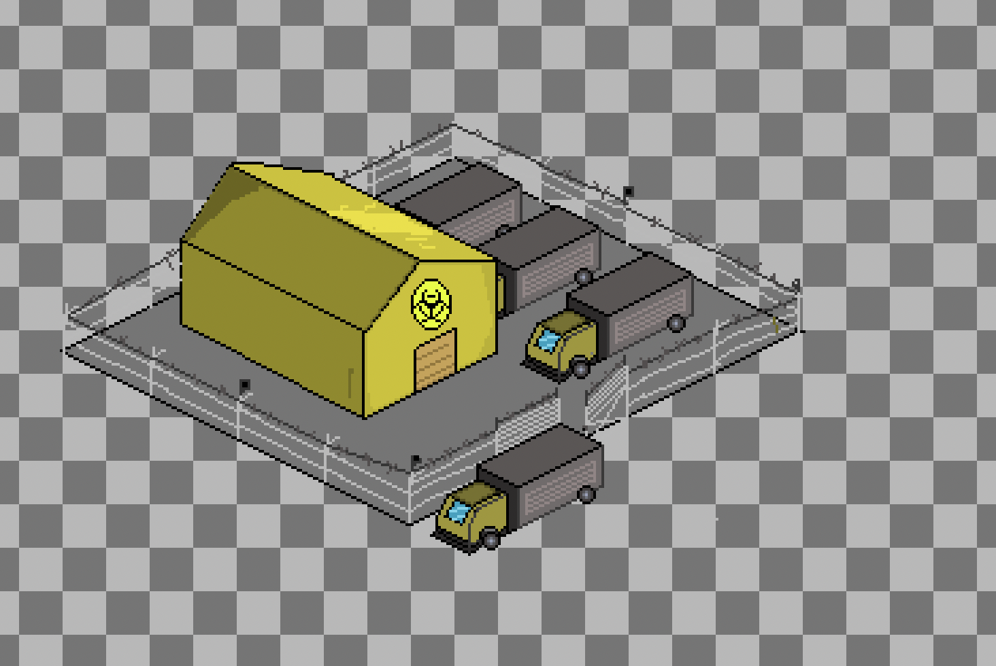
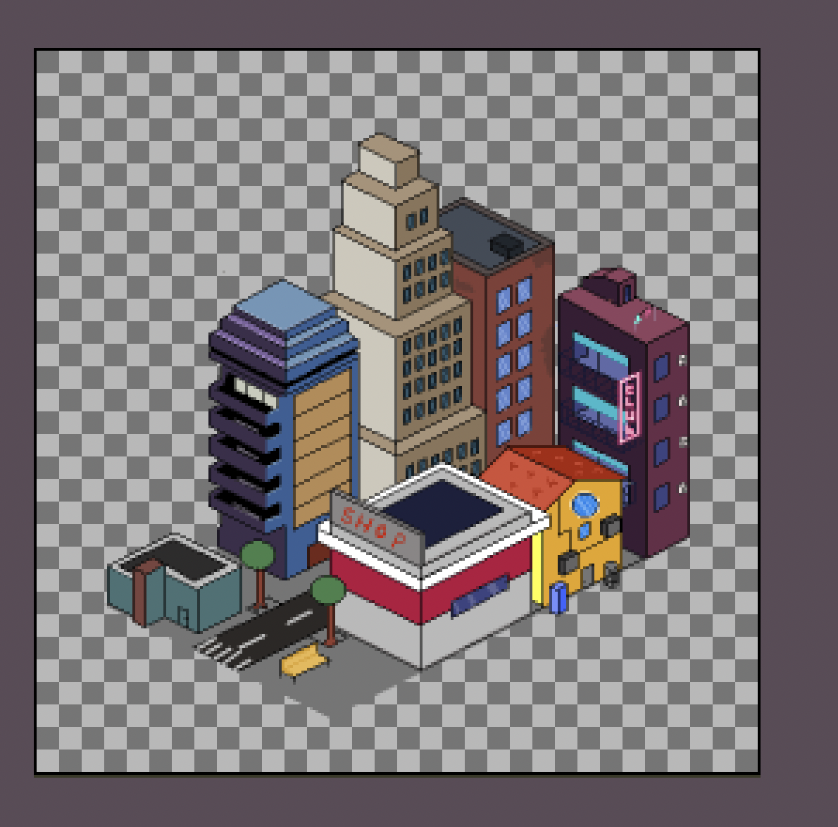
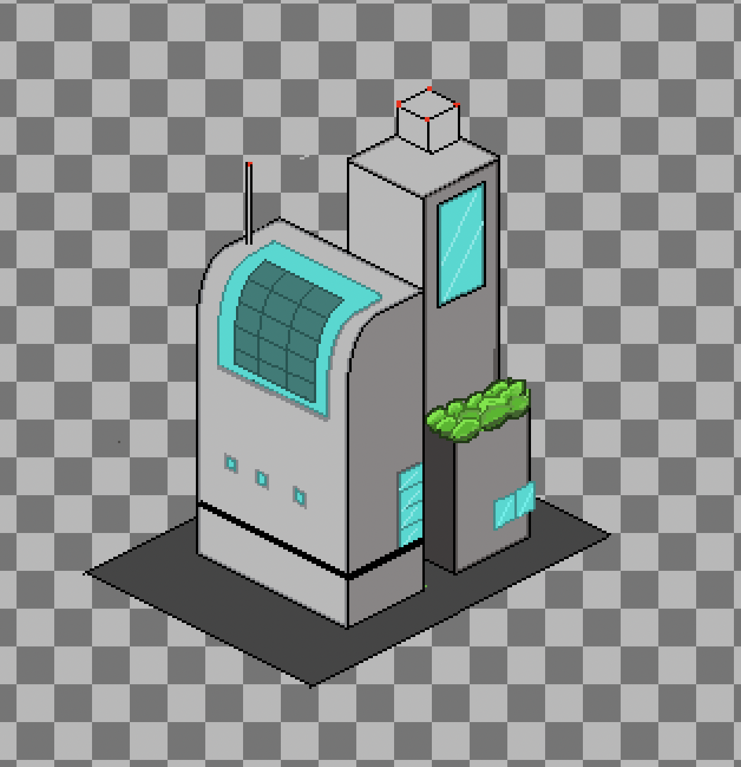
New POIs!

Slide 2

Dreaded Performance Improvements
Rewriting all logic for individual rats to happen on the GPU in a Compute Shader
Good News: Potentially will let us run *millions* of rats
Bad News: Compute Shaders are hard :(
Free movement of rats, selection of rats, targeted movements of rats working.
Working on combat visualisation, and collision with POIs

Slide 3
Evolution
Pick active mutations
Use unique abilities, manage your cooldowns
Some are combat based, some are utilities
Acquire your enemies' mutations if you best them
A mutation from a group increases chance of getting another from that same group
6 mutations, from disease group:
Necrosis
Fester
Pestis
Septic bite
Sewer Dweller

Slide 4

Evolution

Slide 5

Other
Fixed cheese rate not being displayed properly
Started work on Fog of War but paused to prioritise other stuff
Started designing logo
Started work on making hordes able to die except last alive for player
Spread biomes out more
Hordes now retreat to nearest friendly POI when losing combat

